Slide 1
Lab #1: KSDK Project Generator
Objective 1 – Familiarize yourself with the KSDK Project Generator and use the “Quick Generate” feature to create a project
Objective 2 – Import and build your new project in KDS

Slide 2
KSDK Project Generator – Test Drive
The Project Generator executable is located in the SDK Advanced folder on your lab computer’s Desktop
Double click on the EXE file to launch the utility
Spend some time clicking around and experimenting with the tool
Try creating a project using “Quick Generate”
When you feel comfortable with the tool, proceed to the next slide

Slide 3
Objective 1: Create a Project for the Lab
Launch the Project Generator (if you haven’t already)
Return to the main window. If you’re in the Advanced view, click on the Return button
Name your project lab2_project, choose the FRDM-K22F board, and click on the Quick Generate! button
The new project will be located in:
C:/KSDK_1.2.0/examples/frdmk22f/user_apps

Slide 4
Objective 2: Launch KDS
Launch Kinetis Design Studio (KDS)
Create a new workspace. If KDS does not prompt you to select/name a workspace when you launch it, go to File > Switch Workspace > Other and create the new workspace. See an example below:
*After selecting “OK”, KDS will restart

Slide 5
Objective 2: Import Platform Library Into KDS
Go to File > Import and select the Existing Projects into Workspace option under General. Click Next.
Click on the Browse button next to “Select root directory” and navigate to C:/Freescale/KSDK_1.2.0/lib/ksdk_platform_lib/kds/K22F51212 Click OK.
The platform library for the K22F512 will now be listed in the Projects window. Click Finish.
The project will now be in your workspace

Slide 6
Objective 2: Import Project Into KDS
Follow the same steps used to import the platform library, only point to: C:/Freescale/KSDK_1.2.0/examples/frdmk22f/user_apps/lab2_project/kds
Your workspace should now contain two projects, as shown below

Slide 7
Objective 2: Build Application
Before building lab2_project you must build the platform library
Select/highlight the KSDK platform library project and click on the hammer icon to build
After the build completes, select/highlight lab2_project and click on the hammer icon
Both will build without errors or warnings
This is our starting point. Open up main.c and look at what is included. The source file is in lab2_project > source

Slide 8
Lab #2: System Services
Objective 1 – Understand default clock configuration
Objective 2 – Add source files to your new project
Objective 3 – Run the demo as-is to utilize the Clock and Power Managers and view current consumption
Objective 4 – Investigate and understand the application code
Objective 5 – Add a new power mode to the demo application

Slide 9
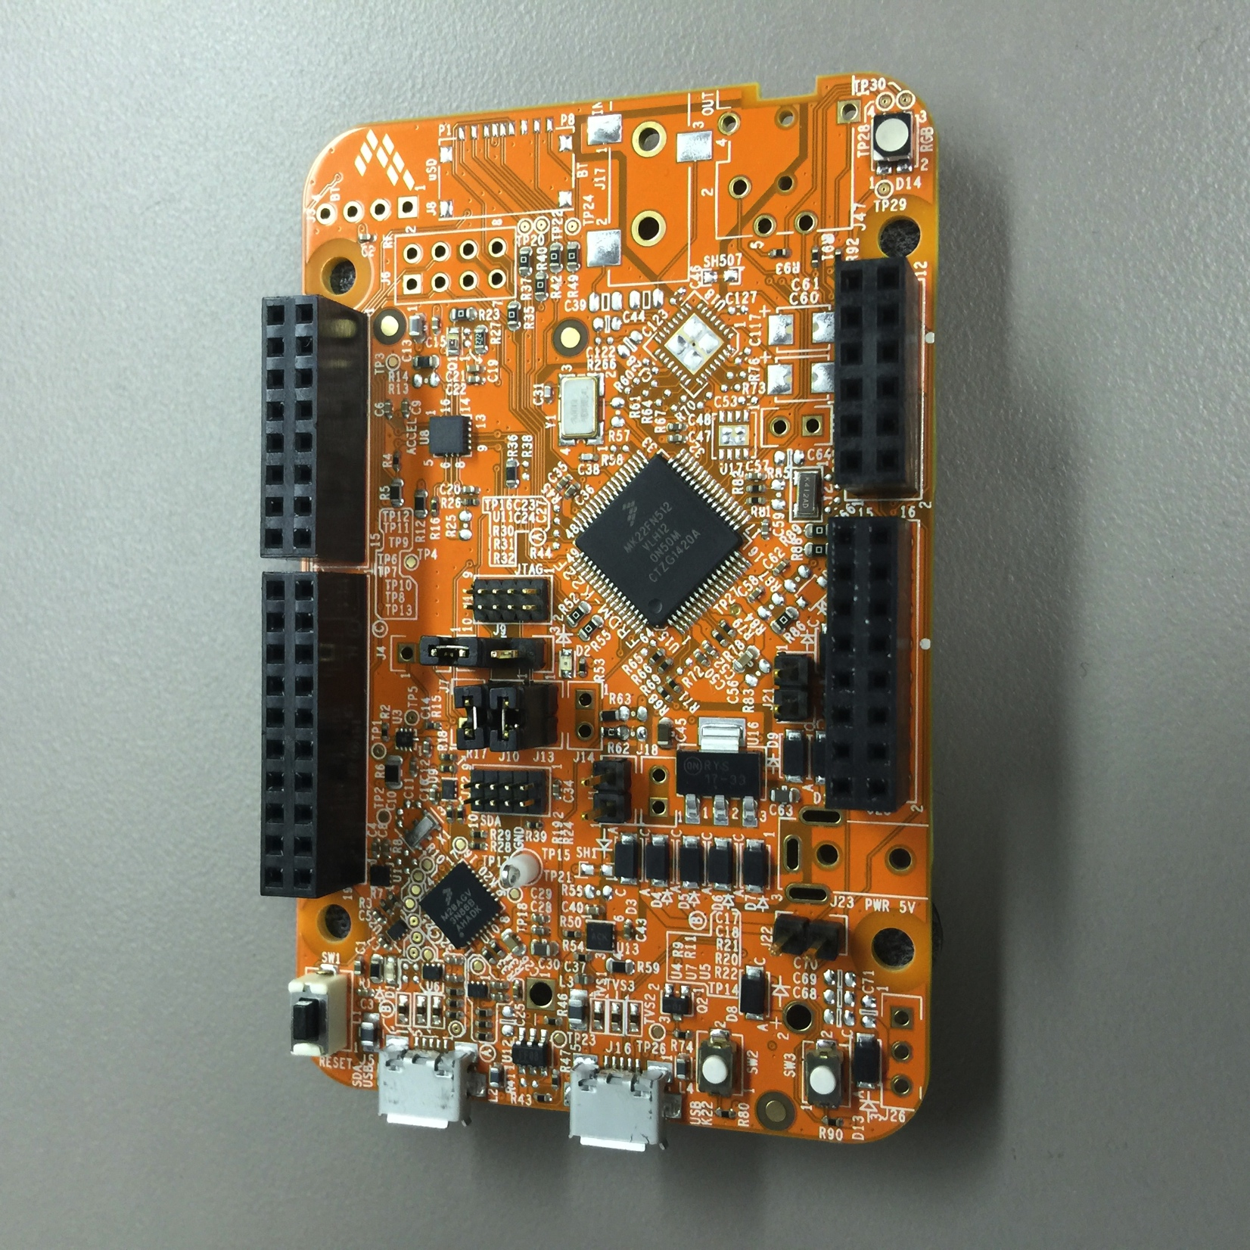
Getting to Know the FRDM-K22F Board
The important sections of the board are shown below. Before applying power, familiarize yourself with these items
Reset button
Debug/Power Connector
J15 (MCU Power Jumper) REMOVE THIS
Wake Switch, SW2

Slide 10
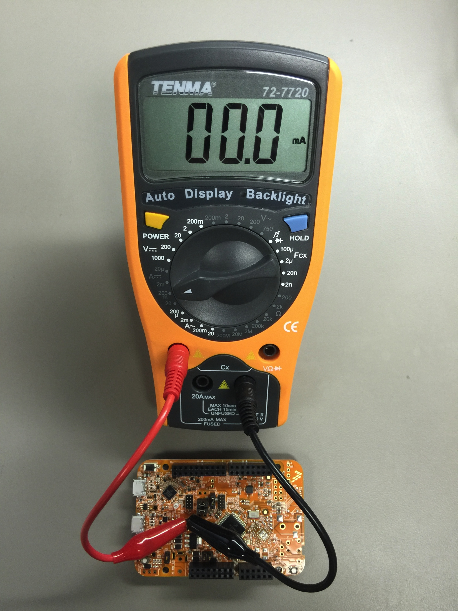
Preparing the Hardware – Part 1
Before powering the board, remove jumper J15
Connect the meter probes to the low current (200mA) terminals of the meter
Connect the probe clips to the MCU power jumper: J15. The positive lead goes to pin 1 (on the USB connector side) and the negative lead goes to pin 2 (on the MCU side)

Slide 11
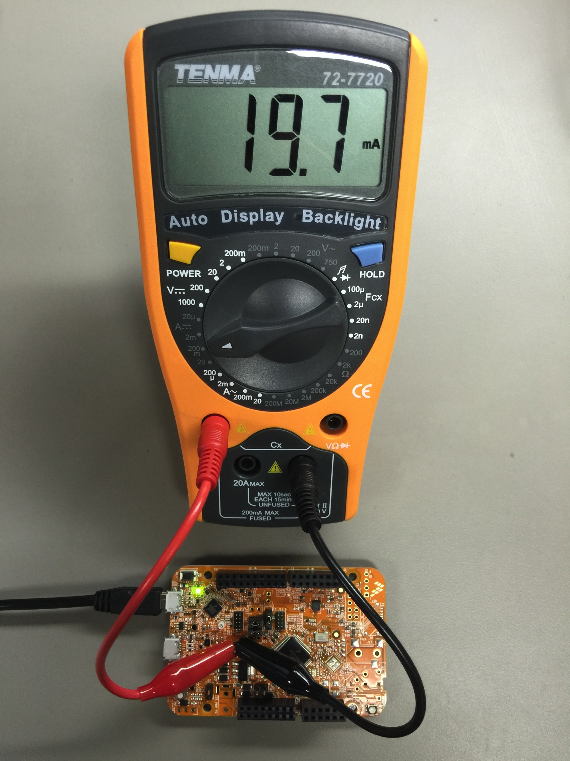
Preparing the Hardware – Part 2
Connect the micro USB cable to the SDA/USB terminal on the board
When the board powers up, it will draw in the 10s of milliamps, depending on the application that was previously loaded into the flash memory

Slide 12
Objective 1: Understand Default Clock Settings
Open the board.c file, located inside the board folder of lab2_project
Starting at the top of the file, you’ll see a set of pre-configured clock configurations for VLPR, RUN and HSRUN (high-speed run)
Find the BOARD_ClockInit() function and look at the calls made by the Clock Manager to set up the clock for the project Test Your Knowledge: What is the default clock frequency used by the project?

Slide 13
Objective 2: Add Source Files
We have provided a system services example application for you to use in the lab, located in the KSDK Advanced folder on your Desktop
Copy the lab2.c file from your Desktop into your newly created project in C:/Freescale/KSDK_1.2.0/examples/frdmk22f/user_apps/lab2_project
With the source file copied, import the source file into your project by right-clicking on the source folder in lab2_project and selecting New > File

Slide 14
Objective 2: Add Source Files (contd.)
In the window that appears, click on the Advanced button and then check the Link to file in the file system box
Browse to the lab2_project folder and select the lab2.c file locate in: C:/Freescale/KSDK_1.2.0/examples/frdmk22f/user_apps/lab2_project
The lab2.c source file is now part of your project

Slide 15
Objective 2: Add Source Files (contd.)
Lastly, copy the hardware_init.c file from the KSDK Advanced folder on your Desktop into your project in C:/Freescale/KSDK_1.2.0/examples/frdmk22f/user_apps/lab2_project
Overwrite the file that is already present

Slide 16
Objective 2: Use New Source Code
The source code in lab2.c is intended to act as the main application for the lab
Modify main() in main.c to look like the following:

Slide 17
Objective 3: Running the Application
Now that the new source is integrated into your project, re-build the application by highlighting lab2_project and click on the hammer icon
To load the image onto the FRDM-K22F board, go to Run > Debug Configurations… Select the lab2_project_frdmk22f_debug_cmsisdap target under GDB OpenOCD Debugging. Click on the Debug button to start

Slide 18
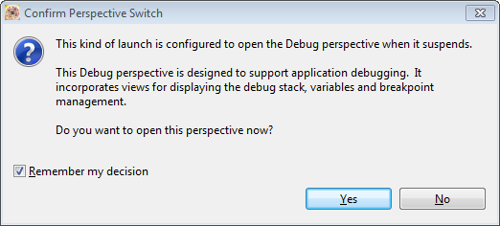
Objective 3: Running the Application
If this is your first time launching a project in this workspace, you will get a dialog window telling you about a perspective switch in the IDE. Check the Remember my decision box and select Yes.

Slide 19
Objective 3: Running the Application
Before starting the application, you must open up a terminal application to observe the demo’s control interface. To determine the COM port, open the Windows Device Manager and look for the mbed Serial Port
Open your terminal application of choice on your PC and connect to the COM port with 9600-8-n-1
In the KDS debugger, click on the Go button (little green arrow) to start the application

Slide 20
Objective 3: Running the Application
The demo will output the following text to the screen:
You can enter various power modes by pressing letters on your keyboard. It is recommended to disconnect the debugger and power cycle the board prior to looking at low power numbers. Use the provided multi meter to measure the current and compare it to the K22F datasheet.

Slide 21
Objective 4: Explore and Understand the Application
After running the application, take some time to look at the source code
The lab2.c file has steps listed/numbered, starting in the lab2_power() function
Go through step-by-step to see how the Clock and Power Managers are configured in the application

Slide 22
Objective 5: Add Support for VLLS3 Mode
If you have time, modify the application to support an additional low power mode: VLLS3
The first step is to add support to the demo application for the new mode. There is an enum on line 63 where this should be done:

Slide 23
Objective 5: Add Support for VLLS3 Mode
Next, add a configuration structure for the new power mode. The easiest way to accomplish this is to copy the structure from another mode and use that as a template. These definitions are found in the section marked as Step 4 in lab2_power()

Slide 24
Objective 5: Add Support for VLLS3 Mode
Now, add the new power configuration to the array of supported power modes, which is part of the section marked as Step 5 in lab2_power()

Slide 25
Objective 5: Add Support for VLLS3 Mode
Browse down to the while(1) loop in lab2_power() and remove the comment from the line that has a PRINTF statement for VLLS3 mode. It’s about line 371, assuming the previous changes have been made correctly:
Remove

Slide 26
Objective 5: Add Support for VLLS3 Mode
Lastly, we need to add a case statement in the while(1) loop in lab2_power() to handle the newly added VLLS3 mode. Since entry into VLLS3 is identical to that for VLLS0, have both share the same handler:

Slide 27
Objective 5: Add Support for VLLS3 Mode
Re-build the application
Assuming the changes were made correctly, there will be no errors. At this point, download the application by launching the debugger. Reference prior sections is you need help doing this.
After loading the application, disconnect the debugger and power cycle the device

Slide 28
Objective 5: Add Support for VLLS3 Mode
Once the board is plugged in again, launch your terminal application. Press the board reset button to reset and run the application. You will now see a new option for VLLS3. Try it out to see the power consumption in the new mode!

